Slide 1

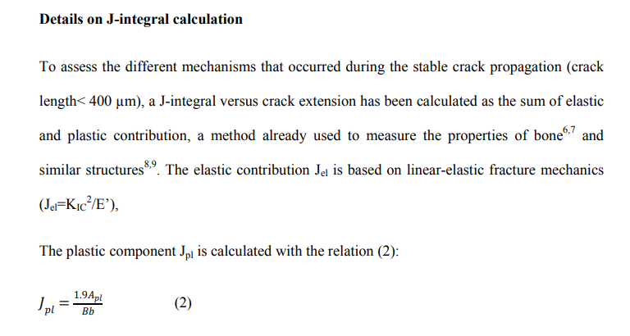
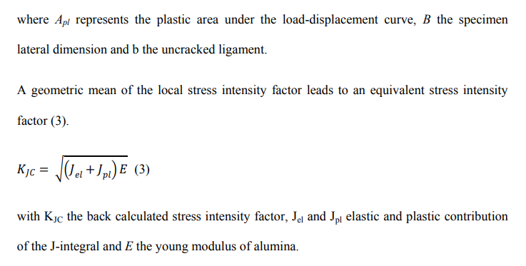
J_elastic, J_plastic calculations

Slide 2
J_elastic, J_plastic calculations
Term Definitions:
K = stress intensity factor is used to predict the stress state near the tip of a crack due to remote/residual stresses
Kc = critical stress intensity factor is the stress at which unstable crack propagation occurs
G = energy release rate, ie. rate at which energy is transformed as a material undergoes fracture
J = integral used to calculate the strain energy release rate per unit of fracture surface area
R-curve = quantification of the principle of increasing fracture resistance, as a function of crack length

Slide 3
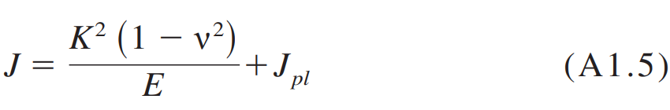
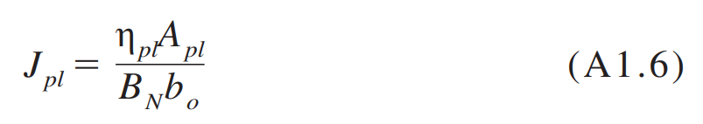
J_elastic, J_plastic calculations
Following E1820:
For basic test method using a notched 3PB test,
Where J_plastic is defined as:

Slide 4
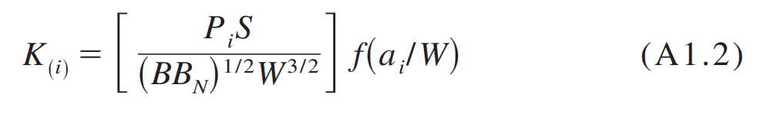
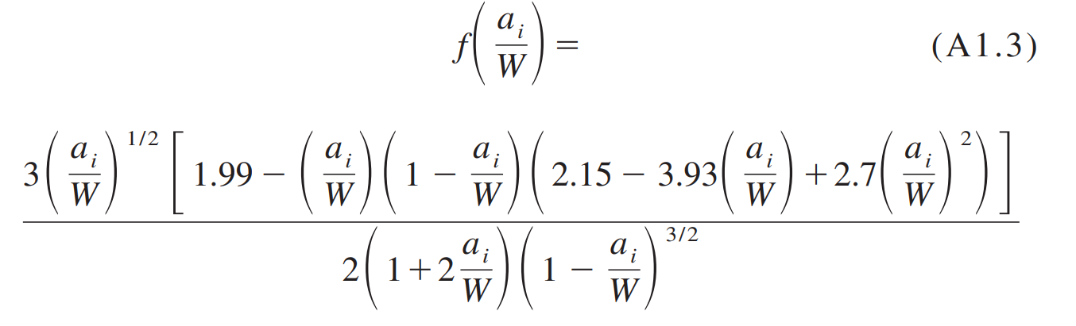
J_elastic, J_plastic calculations
For calculating J_elastic, we first need K:

Slide 5
J_elastic, J_plastic calculations
P_i = force applied (N)
S = span length (m)
B = specimen thickness (m)
B_N = specimen thickness between roots of the side grooves (m) – equivalent to B for our test (E399-20a 8.2.1)
a_i = crack size (m)
W = specimen depth (m)

Slide 6
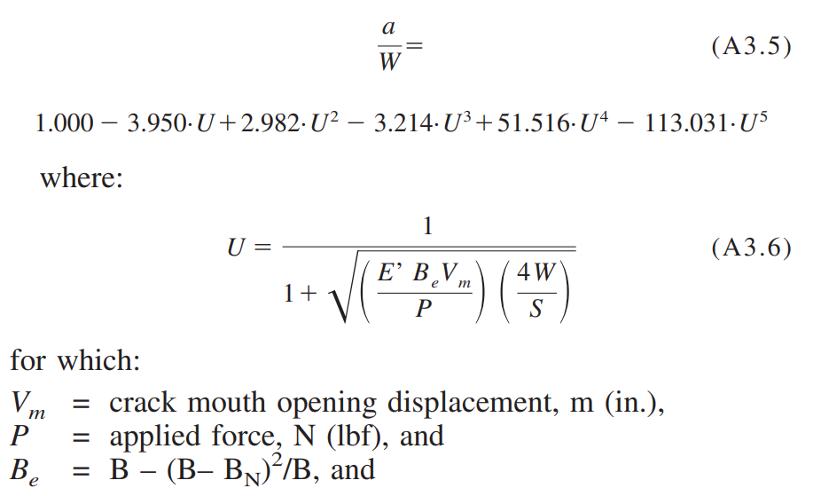
J_elastic, J_plastic calculations
Crack size, a_i, is calculated based on the CMOD measurements shown in the formulas in E399:

Slide 7
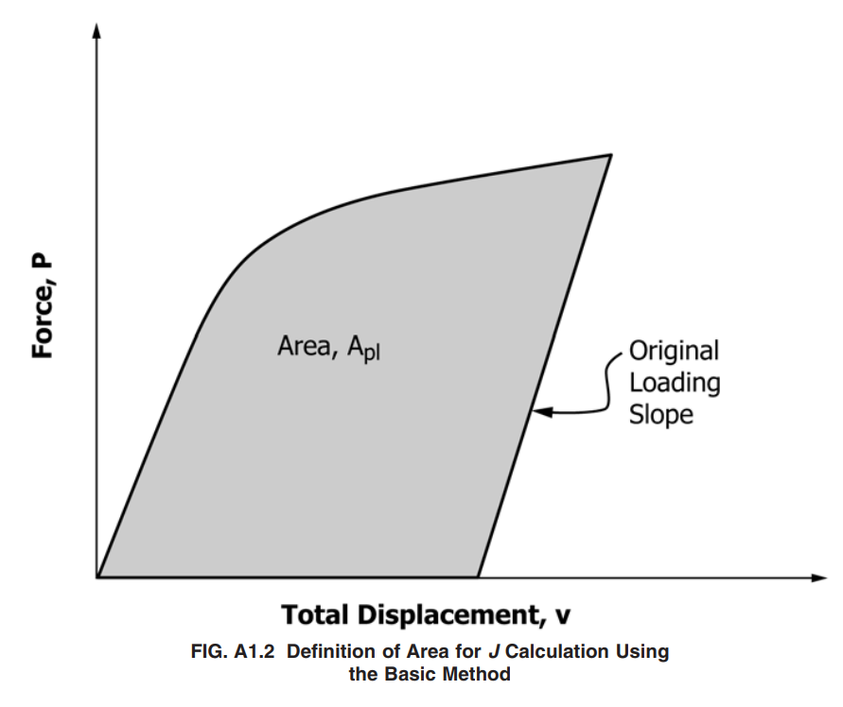
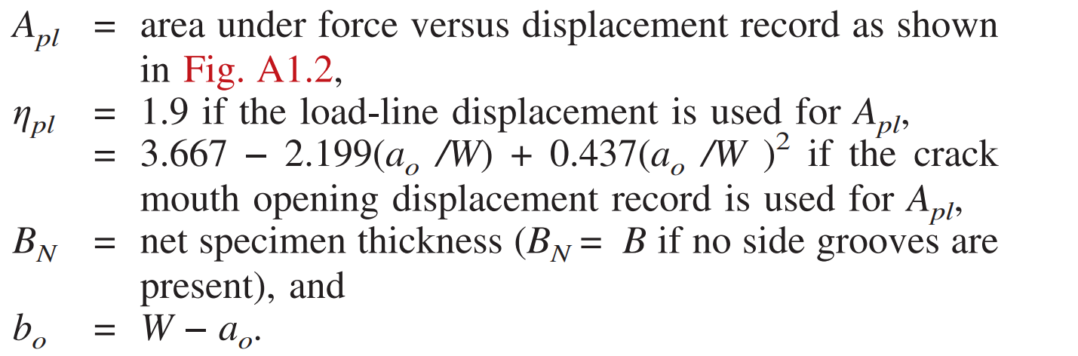
J_elastic, J_plastic calculations
For J_plastic, we need the following terms:
…And alpha_0 = initial crack length

Slide 8
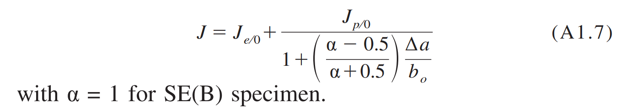
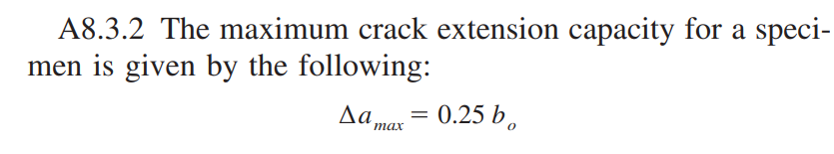
J_elastic, J_plastic calculations
We can then solve for the final J value:
A correction factor is applied to the final J-integral

